Slide 1

Victim – Offender Mediation
Latvian Experience
Andris Šillers
01.08.2017

Slide 2
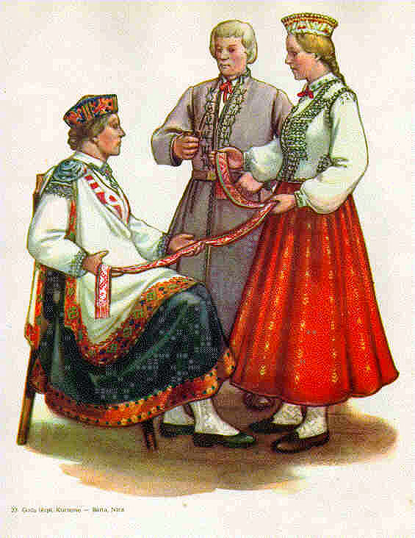
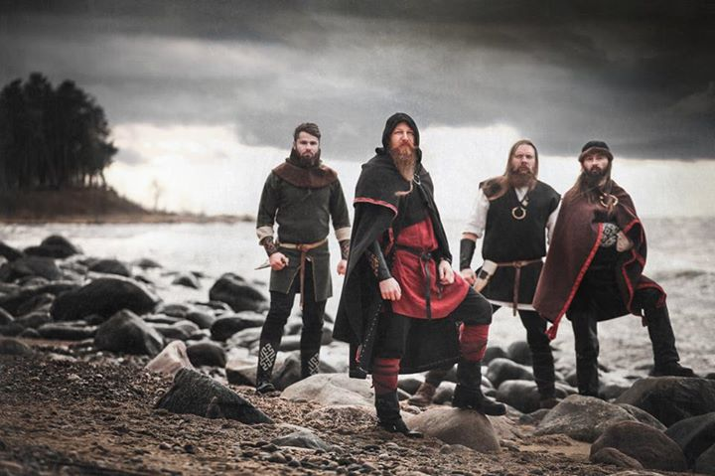
Latvia
Population 1,978 million
1/3 of population lives in Riga
Ethnic groups:
- 61.1% Latvian
- 26.2% Russian
- 3.5% Belarussian
- 2.3% Ukrainian
- 2.2% Polish
- 1.3% Lithuanian
- 3.4% Other
Official language – Latvian, belongs to Indo-European language family
Latvia has ethnic and linguistic ties to Lithuania

Slide 3
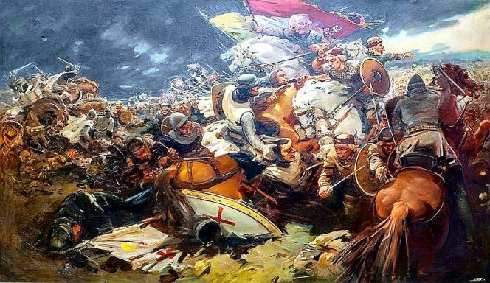
Latvians

Slide 4
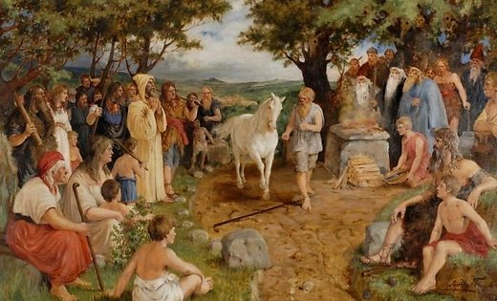
Latvians

Slide 5
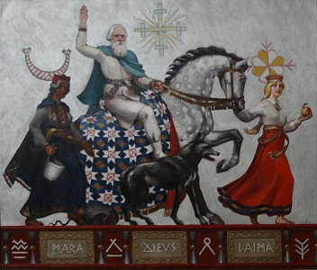
Restorative Justice
Howard Zehr
To put right the wrongs

Slide 6

Five Principles of Restorative Justice
1. Focuses on harms and consequent needs
(victims', but also communities' and offenders')
2. Addresses obligations resulting from those harms
(offenders' but also families', communities' and society's)
3. Uses inclusive, collaborative processes.
4. Involves those with a legitimate stake in the situation
(victims, offenders, families, community members, society)
5. Seeks to put things right.

Slide 7
Focus on Needs and Roles
Victim needs – Information why, tell what happened, gain control, restitution
Offender accountability – what has been done, understand impact on their behavior
Community involvement – secondary victims, mutual accountability, preventive actions

Slide 8
Two Different Views
Criminal Justice
Crime is a violation of the law.
Violations create guilt.
Justice requires the state to determine blame (guilt) and impose pain (punishment).
Central focus: offenders getting what they deserve.
Restorative Justice
Crime is a violation of people.
Violations create obligations.
Justice involves victims, offenders and community members.
Focus: victim needs and offender responsibility for repairing harm.

Slide 9
Restorative Justice
Restorative Justice is a problem-solving approach to crime which involves the parties themselves, and the community generally, in an active relationship with statutory agencies.
/Tony F. Marshall/

Slide 10
Victim – Offender mediation (VOM)
VOM - voluntary face-to-face negotiations between the victim and the offender, held by a neutral person – mediator, who gives assistance to the parties involved to reach mutually acceptable, impartial and just solution.

Slide 11

Mediator
Recruitment and selection
28 h training course
3 mediations under supervision
Final test
6 - 20 mediations in 2 year period
Every 12 month 8 h additional training
After 24 months recertification

Slide 12
When is VOM possible
In all types and stages of Criminal procedure.
Application may be required by:
parties (victim, offender, parents);
police;
public prosecutor;
court;
judge (cases of Law on Compulsory Measures of Correctional Nature for Children).

Slide 13
The main principles of VOM
Face–to–face meeting (exception when victim is minor);
Voluntary participation;
The offender admits wrongdoing;
Parties are free to refuse negotiations at any time;
Supporters of the parties or other affected persons may be involved ;
Mediator - process, neutrality and confidentiality.

Slide 14
VOM Session
Preparing parties
Ensure comfortable conditions
Lead mediation process
Session 1 – 2 h
Number of sessions depends on a case

Slide 15
VOM Session
Fact checking and negotiations
I Stage – past
What happened? How? Where? Who was involved?
II Stage – present
What do you think about the incident now? What are consequences? How do you feel about what happened now?
III Stage – future
What should be done to leave incident in the past?
What solution do you see?
Victim and offender contract

Slide 16
VOM Session
Mediator
Victim
Offender
Supporter
Supporter
Mediator

Slide 17
Conferencing
Negotiations are guided by a special script.
Participate those who have been affected by the offense.
More participants (social pedagoues, police, children protection officers etc).
Always two falicitators.

Slide 18
Conferencing
Facilitator
Victim
Offender
Supporter
Supporter
School representative
Community representative
Facilitator

Slide 19
Victim benefits of VOM
A chance to express feelings and viewpoint about the incident directly.
Receive answers on significant questions.
Maintain neutral relationship with offender.
An opportunity to receive restitution faster.

Slide 20
Offender benefits of VOM
An opportunity explain reasons for wrongdoing.
Restitute victim.
Understand consequences of incident for victim.
Receive less severe punishment.

Slide 21
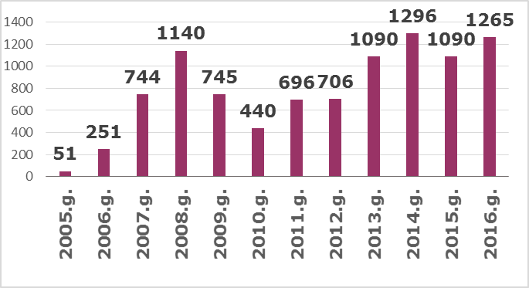
VOM Dynamics Over the Years

Slide 22
Krimināllikuma pants (pilngadīgie un nepilngadīgie) | 2015 | 2016
Par zādzību, krāpšanu vai piesavināšanos nelielā apmērā (KL 180/1) | 307 | 415
Par zādzību, ja tā izdarīta, iekļūstot dzīvoklī vai citā telpā, vai ja tā izdarīta no glabātavas vai transportlīdzekļa (KL 175/3) | 247 | 182
Par svešas mantas tīšu iznīcināšanu vai bojāšanu (KL 185/1) | 205 | 218
Par svešas kustamas mantas slepenu vai atklātu nolaupīšanu (zādzība) (175/1) | 75 | 49
Par viegla miesas bojājuma tīšu nodarīšanu (KL 130/2) | 52 | 77
Par ceļu satiksmes noteikumu vai transportlīdzekļu ekspluatācijas noteikumu pārkāpšanu (260/1, 260/1.1) | 46 | 38
Par tāda miesas bojājuma tīšu nodarīšanu, kas izraisījis ilgstošu veselības traucējumu vai vispārējo darbspēju ievērojamu paliekošu zaudēšanu mazāk nekā vienas trešdaļas apmērā (KL 126/1) | 43 | 37
Par laupīšanu, ja to izdarījusi personu grupa pēc iepriekšējas vienošanās vai ja tā izdarīta, iekļūstot dzīvoklī vai citā telpā (176/2) | 26 | 29
Par huligānismu, ja to izdarījusi personu grupa vai ja tas saistīts ar miesas bojājumu nodarīšanu (231/2) | 22 | 19
Par zādzību, ja to izdarījusi personu grupa pēc iepriekšējas vienošanās (175/2) | 20 | 26
Par svešas kustamas mantas nolaupīšanu, ja tā saistīta ar vardarbību vai vardarbības piedraudējumu (laupīšana) (176/1) | 20 | 26
Par sveša finanšu instrumenta vai maksāšanas līdzekļa nolaupīšanu, iznīcināšanu, bojāšanu vai nelikumīgu izmantošanu (193/2) | 14 | 19
Par svešas mantas prettiesisku iegūšanu vai izšķērdēšanu (179/1) | 13 | 15
Par svešas mantas vai tiesību uz šādu mantu, vai citu mantisku labumu iegūšanu, apzināti ievadot automatizētā datu apstrādes sistēmā nepatiesus datus (177/1) | 11 | 14
Un citi (KL 109/1, 132, 143, 231/2, 174, 230/1, 275/2 ) | Līdz 10 | Līdz 10

Slide 23
Conditions

Slide 24
Restorative Justice
All violence is an effort to achieve justice or to undo injustice.
/James Gilligan/
In other words, much crime may be a response to an effort to undo a sense of victimization.

Slide 25
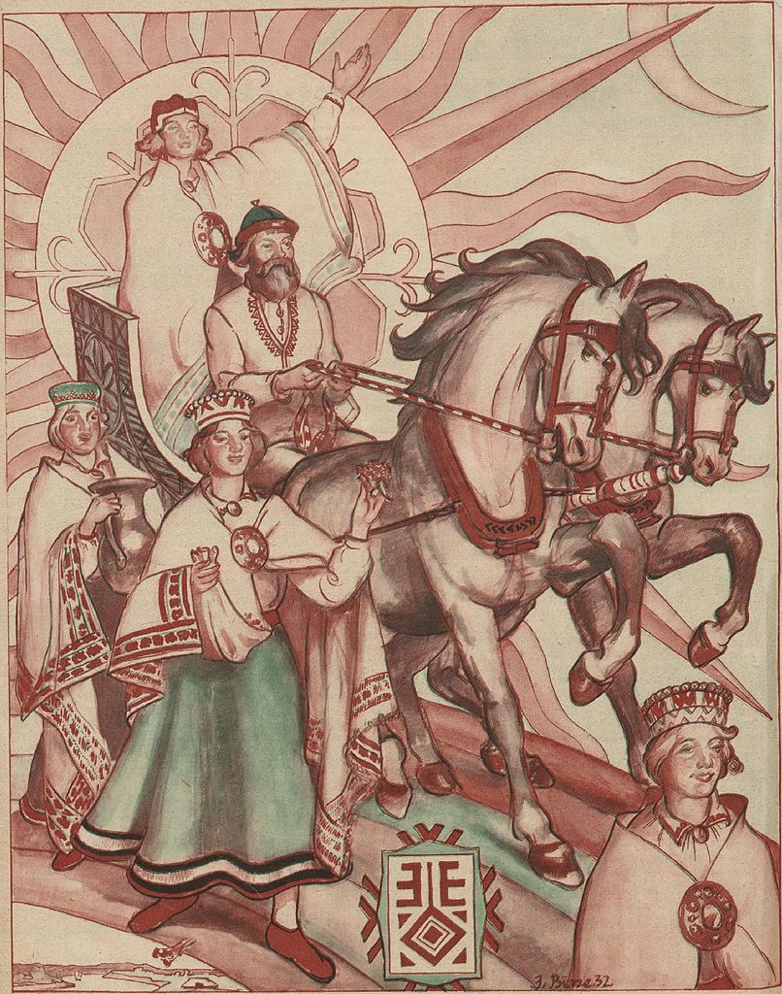
Thank you!

