Slide 1
The Role of Culture in Conflict Management and Negotiations
Tarmo Tuisk
Tallinn University of Technology
28.07.2017

Slide 2
Agenda
Understanding cultural differences
Fast and slow messages
High and low context cultures
Space and time
Monochronic people and polychronic people

Slide 3
Understanding cultural differences
Even though culture is perceived personally, it is nonetheless a shared system.
As culture is experienced personally, very few individuals see for what it is – a program of behaviour.
Members of a common culture not only share information, but also methods of coding, storing and retrieving of that information.
These methods vary from culture to culture.

Slide 4
Cultural differences – hidden?
Knowing what kind of information people from other cultures require is one key to effective international communication.
“Hidden codes” of behaviour need “code breaker” to be understood.
90% or more of all communication is in culture’s nonverbal messages (i.e. not language).

Slide 5
Culture is communication
Each cultural world operates according to its own internal dynamic, principles and laws (written & unwritten), also time and space.
But common for each culture are:
words, material things and behaviour.
Words: medium of business, politics and diplomacy
Material things: indicators of status and power
Behaviour: feedback about people feel and includes techniques to avoid confrontation.

Slide 6
“Silent language”
…human behaviour that exists outside conscious awareness.
…includes evolutionary concepts, practices, solutions to problems, shared experience of ordinary people.
“Provides insights into the underlying principles that shape our lives.”
These principles are not merely interesting, but eminently practical.

Slide 7
Fast and slow messages
Cross-cultural communication has more to do with releasing right responses than sending “right” messages.
Information can be sent in different speed.
A fast message to them who have used to have it in slow format will miss the target.
Although people can understand the content of wrong-speed message, for them who expect it in different speed it won’t be understandable.
People are not (always) aware that the information can be sent in different speeds.

Slide 8
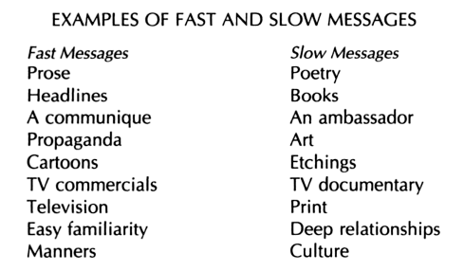

Slide 9
Fast and Slow Messages
Almost everything in life can be placed somewhere within fast/slow message spectrum.
Slow mode: research, diplomacy, writing books, creating art.
Messages of Buddha, Confucius, Goethe, Rembrandt are still now – hundreads of years after the fact – under deciphering by human beings.
Very slow messages: a person, a language, and culture – incorporating multiple styles of “languages” where messages are released for them who are willing to spend time to understand it.

Slide 10
High and Low Context
Context – the information that surrounds the event.
The elements that combine to produce a given meaning – events and context – are in different proportions depending on the culture.
High context (HC) communication or message is the one where most of the information is already on the person, and very little is in the coded, explicit, transmitted part of the message (e.g. twins communicating with each other).
Low context (LC) – the mass of the information is vested in the explicit code (e.g. two lawyers in the courtroom during a trial).

Slide 11
HC people and LC people
HC people: Japanese, Arabs, Mediterranean.
(having extensive information networks among family, friends, colleagues, clients. Beacuse of daily information exchange their messages are high-context).
LC people: Americans, Swiss, Germans, Scandinavians, other Northern Europeans.
Example: The French are much higher on the context scale than either Germans or Americans.

Slide 12
Space
Territoriality – e.g. what is “mine” for Germans is not percieved the same way for Americans (e.g. touching a car..).
Space communicates power (e.g. location of the boss in the office).
Personal Space – a “bubble” around a person (North vs. South)
Unconsious Reactions to Spatial Differences

Slide 13
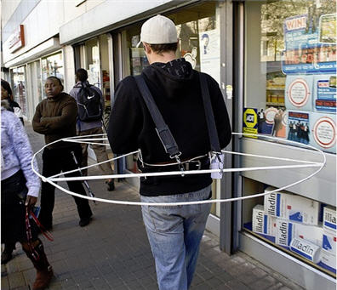

Slide 14
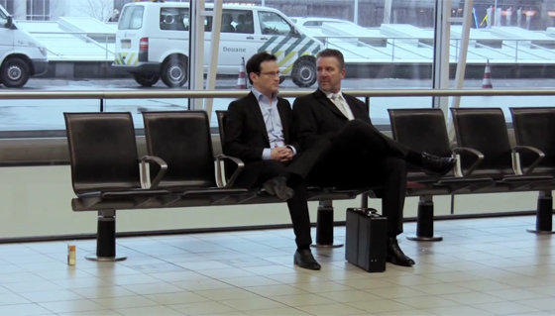

Slide 15
Personal territory
Intimate distance for embracing, touching or whispering.
Personal distance for interactions among good friends or family members.
Social distance for interactions among acquaintances.
Public distance used for public speaking.
Realizing and recognizing these cultural differences improves cross-cultural understanding, and helps people to eliminate discomfort feeling if the interpersonal distance is too large ("stand-offish") or too small (intrusive).

Slide 16
Time
Monochronic and Polychronic Time
Monochronic – paying attention and doing only one thing at a time. Time is experianced and used in a linear way. Perceived as tangible: “spent”, “wasted”, “saved” and “lost”.
Polychronic – simultaneus occurance of many things by great involvement of people. More emphasis on completing human actions than meeting the schedules.

Slide 17
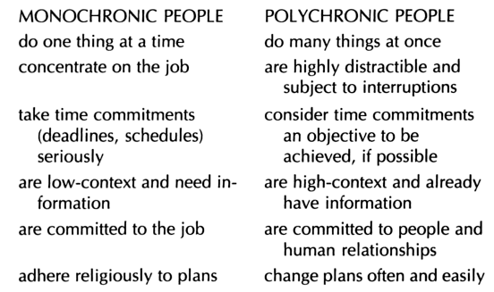

Slide 18
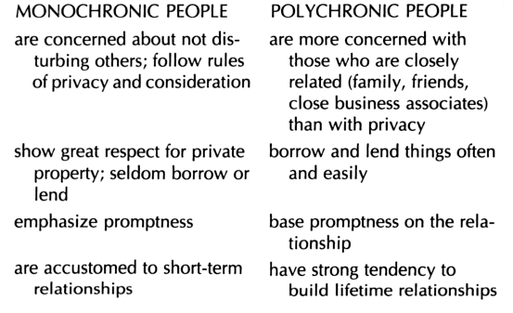

Slide 19
Relation between Time and Space
MT culture: emphasis is on the compartmentalization of functions and people (e.g. private offices are soundproof).
PT culture: business offices with large reception areas; polychronic people feel that private space disrupts the flow of information; appointments mean very little and may be shifted around at the last minute in the sake of someone who is more important in individual’s hierarchy of family, friends or associates.
NB! Monocrhonic vs Polychronic Time culture – this dichotomy cannot be overemphasizied.

Slide 20
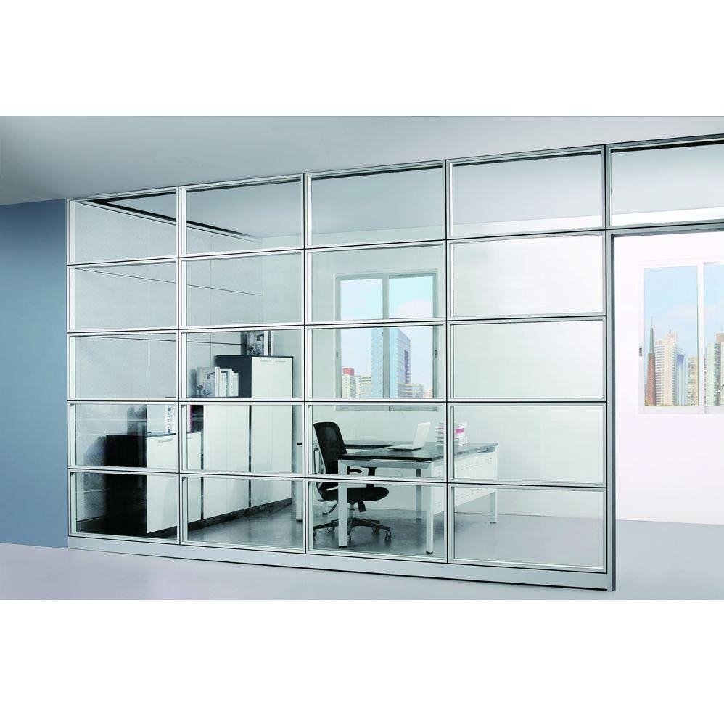

Slide 21


Slide 22
Time as Communication
Tempo, Rhythm, Synchrony:
(e.g. Americans complain: Germans take forever to reach decisions)
There is a need to be contexted to local time system.
Scheduling and Lead Time
USA and Germany: schedules are sacred.
Short lead time means the business is less important (e.g. in Germany two weeks minimum, in Arabic culture 3-4 days is sufficient).

Slide 23
The Importance of Proper Timing
Announcements of major changes must be carefully timed.
USA and northern Europe: anything that occurs outside business hours refers to ‘emergency’.
E.g. in August in France everything shuts down for vacances.
Common in US is short lunch vs. longer dinner in France to get acquinted with business partners.

Slide 24
Appointments
Long waiting-time in the U.S. and Germany: a delibarate putdown and/or a message about the individual being very disorganized.
In France: no such message is intended.
Interactions between monochronic and polychronic people can be stressful unless both parties know and decode the meanings behind each other’s language and time.

Slide 25
Action Chains:
The importance of completition
Monochronic low-context cultures: compartmentized approach and dependence on schedules are more sensitive to interrputions, and more vulnarable to the breaking of action chains compared to high-context cultures.
High-context people are more elastic because of their extensive and cohesive networks in their system.

Slide 26
Action chains and disputes
All cultures have in-built safeguards to prevent a dispute from escalating.
These safeguards apply only within the context of one’s own culture.
In foreign situation where a dispute appears imminent it is essential to do two things:
Proceed slowly, taking every action possible to maintain course;
Seek the advice of a skillful, tactful interpreter of the culture – a mediator.

Slide 27
Summary
Understanding High Context and Low Context cultures and their differences
Monochronic and Polychronic Time cultures
Speed of messages
Context
Space and time
Action chains
All these are essential to understand in situations of conflict management and during negotiations.
In each cultural context all acts, all events and all material things have meaning.

Slide 28
Literature
Hall, E. T., Hall, M. R. (1990). Understanding Cultural Differences. Intercultural Press.
Hall, E. T. (1973/1990). The Silent Language. Anchor Books Editions : New York
Hall, E. T. (1977/1989). Beyond Culture. Anchor Books Editions : New York.

