Slide 1





NORDPLUS Intensive Course „Green Logistics”
IEVA BRUKSLE
Supply chain management

Slide 2
Supply chain management
Bussiness university Turība
Lecturer MBA, M.iur. Normunds Kozlovskis
RIGA 2019

Slide 3
The emergence of term “Logistics”
Logicos – calculable, detectable ( Greek)
Initially military term ancient Byzantium – means pay salary to troops, armed, secured, prepared for a crusade
Ancient Rome empire- conditions for food distribution
Initially- term related to military activities: supply, deployment, resistance planning and calculation.

Slide 4
Logistics science development
A. H. Jomini (1779-1869) sees logistics as practical skills in commanding troops. Used by the Napoleonic Army to plan supplies of war material and provisions.
1884. American Navy Institute introduces the concept of logistics in navigation;
Logistics as a science with a civilian application began to develop in the 1950s in the US. The military logistics experience gained in World War II began to be used in civilian operations.

Slide 5
Systemic approach
The diagram shows how logistics, from simple process service, has evolved into a systemic approach to conducting business processes, addressing processes as a whole and streamlining commodity flows from their origin to the final consumer.

Slide 6
1960
FRAGMENTATION
1980
CONSOLIDARION
1990
INTEGRATION
2000
VALUE
2010
AUTOMATIZATION
REQUEST
FORECASTING
SUPPLY
MATERIAL MANAGEMENT
NECESSITIES
PRODUCING
PRODUCING STOCKS
lOGISTICS
SUPPLY CHAIN MANAGEMENT
WAREHOUSES
WAREHOUSES
MATERIALS TREATMENT
MATERIALS TREATMENT
PACKAGING MATERIALS
PACKAGING
INVENTORY
FISICAL DISTRIBUTION
INFORMATION TECHNOLOGIES
ORDERS MANAGING
SALES/MARKETUNG
TRANSPORT/CLIENT SERVICES
STRARTEGIC PLANINF/FINANCES

Slide 7
Genesys of logistic processes century XX- XXI
Phragmentation yy- 1920-1950
Increase in volume of goods and transport costs into distribution systems;
Increase in freight transport tariffs;
Marketing concept implementation;
Development of military logistics practice and theory;
Transition from producer market to consumer market.
The first NGO: National Procurement Issues Association - founded in the United States in 1915.

Slide 8
Creating of Logistics– 1950 – 1970. yy.
It is characterized by intensive development of theoretical and practical logistics
Iimplementation of marketing philosophy in companies
Thenecessity rapidly reduce the cost of servicing logistic processes
Implementation of the concept «total physical distribution»
Advances in information technology
Stock keeping changes to inventory management
Positive impact of military logistics
Developed consumer market with wide assortment of goods and struggle for the buyer. Standardization of transportation and packaging

Slide 9
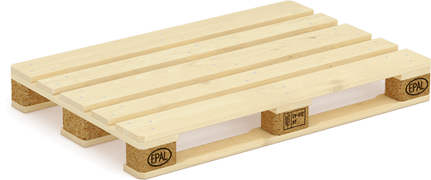
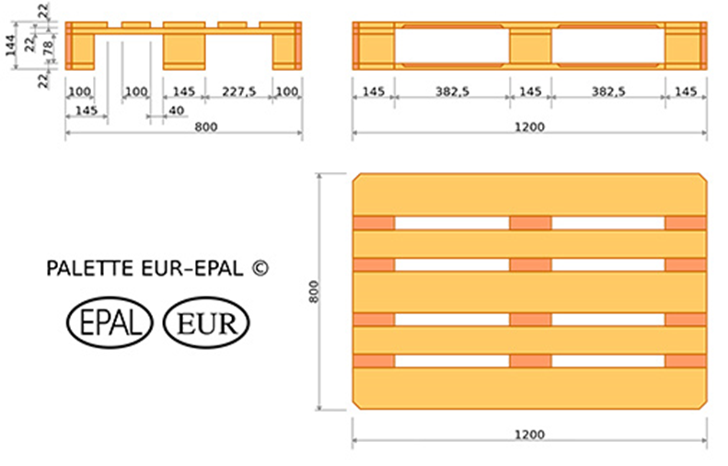
EPAL system

Slide 10
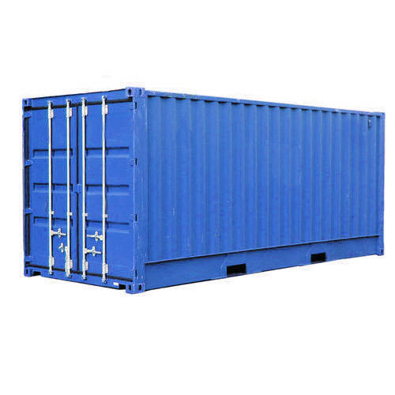
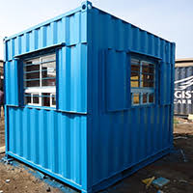
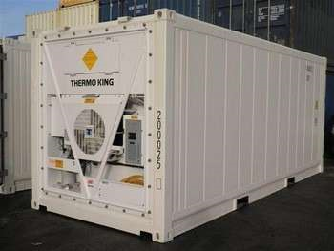
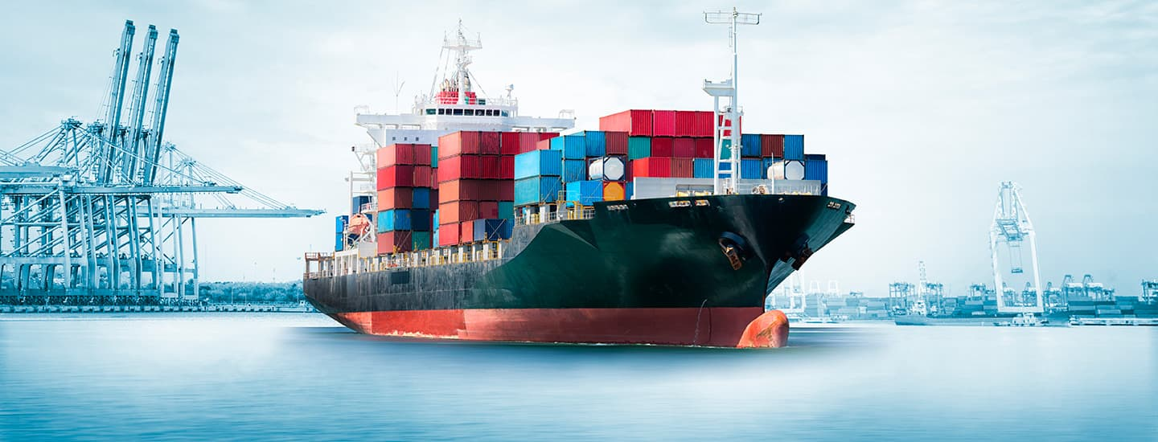

Slide 11
EXERCISE
From station A and station B simultaneously arrived 2 trains facing each other
A trains speed 90 km/h, B trains speed 60 km/h
Direction between stations 600 km.
How many km from stations trains will meet?

Slide 12
Logistics development 1980- 2000
Implementation of the principle of integration
Extensive implementation of personal computers in household and business
Globalization of the market
Changes in the legal framework for economic infrastructure
Quality Management Philosophy and Systems (TQM)
Partnership and strategic business alliances;

Slide 13
Millennium trends in Logistics
Supply chain management born USA beginning 1980
Logistics process and business management in combination
Intensive global market competition
Goods with a short life cycle
Increased consumer demands for quality
Development of transport and communication technologies.
Collaborate to cooperate. Competition between companies is replaced by competition between supply chains.
Oliver.K., Webber.M. Supply chain management: Logistics catches up with strategy. Chapman and Hall, 1982. P 63-75

Slide 14
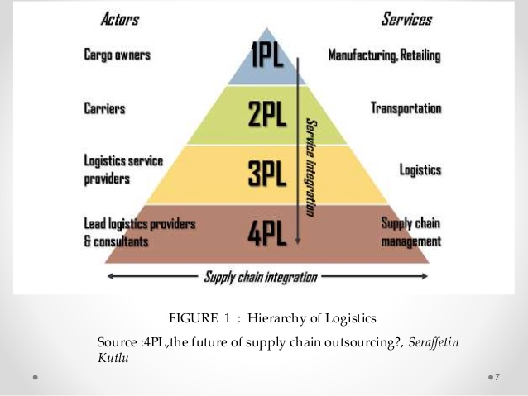
Hierarchy of logistics processes

Slide 15
Supply chain advantages
5-15% increase in profit
20-40% reduction in order processing time and costs
15-30% product implementation time reduction
Purchase costs are reduced by 5-15%
Decrease in stock by 20-40%
Decreases production costs by 5- 15%
AMR research, Accenture, Forrester research

Slide 16
Supply chain definition
Supply chain management is the strategic and systematic co-ordination of traditional business functions within a company and between all companies in the supply chain with the aim of improving long-term performance for each of the companies involved and for the supply chain as a whole.
Cooper. M.C., Ellram, L. M.Characteristics of supply chain management and the implications of purchasing and Logistics Strategy. The international journal of logistics management. 1993. Nr. 4(2) p. 13

Slide 17
Leading Trends in Logistics Services currently
Expansion of logistics service providers' competencies towards 3PL and 4PL
Involvement of logistics operators in analytical work
Increasing the range of services and technical capabilities of 3PL operators
Deeper integration of logistics companies into customer planning processes
Consolidation and growth of logistics operators
Logistics Operators focus on global market
Extension of the duration of operational contracts

Slide 18
Functions of operational logistics
Transportation
Warehouse maintenance and cargo handling
Packaging and repackaging
Management of individual order processes
Customs and legal formalities
Providing information flows
Management of retrograde (back) flows of goods
Management of informational flows
Management of financial flows

Slide 19
Functions of coordination
From logistics function management to business process management
Business Processes - interrelated functions, operations that turn company resources into a company expected result
The use of outsourcing
Change of ownership of inventory management functions
3PL logistics operator appearance the market
KPIs (Key Performance Indicators): Units of Performance
Min.Costs +time = quality

Slide 20
Why does SCM appears
The use of coordinating logistics as a source of enterprise and supply chain competitiveness
Opportunities for new coworking and cooperative relations as an integration perspective in the SC
Growth of technological capabilities, in particular by combining production, processing and information flows in a growing market for IT services and capabilities
Need to ensure maximum of information on available capacities and stocks in the SC
Monitoring KPIs and key business processes with the ability to detect and prevent deviations in a timely manner

Slide 21
Conflicting nature of SCM implementation
The reason of the conflicting introduction of SCM structures is dissatisfaction with the performance of functional units
Procurement management
Production management
Sales management
Marketing Management, Finances, etc.
The traditional approach to logistics as an item of costs
The need for an inter-functional control mechanism
A progressive alternative to coordinating logistics.
4PL Providers - Solution and Conflict Resolution in Affiliated Companies.

Slide 22
Problems of Logistic development in Latvia
Logistic functions during the occupation of the USSR - operation in the
The need for a scientific approach after regaining independence
Lack of local staff in 1990’s
Specifics of the organization of sea, air and rail freight transport during the occupation of the USSR
Scientific work in logistics - at the turn of the century
Potential Impact of Transit Freight on Logistics Specialists' Growth;
Local universities: RTU, TSI, EKA, TU

Slide 23
New functions of SCM
Inventory management
Integrated planning and management of supply chains
Inter-organizational and inter-functional management (coordination)
Logistics service quality management
Product life cycle management
Management of information flows
Two functional control groups:
Operational Management (3P/4P);
Coordinating leadership.

Slide 24
Operational logistics

Slide 25
Logistic operation - an elementary operation or a set of operations aimed at changing the parameters of flows.
The existence of a logistic operation is determined by
Change of time, physical and chemical properties of the object;
Venue localization changes
Involvement of a natural person in an operation
Associating a technical or business unit to perform an operation
Changes object physically and changes information flow
Changes accounting data - resources, time labor, ...
Combining of operations forms processes, flows has build from processes

Slide 26
Criteria for choosing a mode of transport:
Minimal transportation costs
Freight delivery time
Maximum safety and reliability
Minimizing expense on inventory of goods on the move
Desired transport capacity and availability
Differentiation according to the characteristics of the product transported.
Freight forwarding and loading and unloading costs are included in freight costs.

Slide 27
Linkage of transport to other functions
Joint planning with different modes of transport (intermodal transport)
or with multiple modes of transport (multimodal transport)
Ensuring technological integrity of transportation and warehouse processes
Joint planning of transport and production processes.

Slide 28
Types of transport
Rail transport
Water transport (sea or inland)
Road transport
Air transport
Pipeline transport.
There is no good or bad transport, there are good or bad solutions for its application.

Slide 29
Railroad transport
Advantages
Disadvantages
High transport intensity in transport unit
Not depends on the weather;
Does not depend on the time of day
High regularity of transportation
Relatively low rates
Good conditions for transit
High delivery speed over long distances
Natural monopol - small number of carriers
Huge investments in infrastructure
High transport material and energy intensity
Poor access to end-patch sites
Iinsufficiently secured risk of cargo loss

Slide 30
Sea transport
Advantages
Disadvantages
Intercontinental transport
Lowest cost of transportation over long distances
High transport intensity per transport unit
Low cargo transport unit capital intensity
Limited transportation area
Low delivery speed
Dependence on geographical, navigational and meteorological conditions
Low transmission frequency
High requirements for packaging and cargo securing
Complicated and expensive port infrastructure.

Slide 31
Road transport
Advantages
Diadvantages
High Availability, Door to door
High maneuverability, dynamics, adaptability
High delivery speed
Usage of route variations and delivery schemes
High cargo hold capacity
Delivery in small batches
Possibility to choose the appropriate carrier
Low transport intensity per transport unit
Dependence on nature and road conditions
Relatively high cost of long distance transportation
Disruptive effects on the environment
Effect of loading time on overall transportation
Risks of cargo hijacking andvehicle steeling

Slide 32
Air transport
Advantages
Disadvantages
Highest delivery speed
High security
Minimal risk of cargo loss
Transport road length optimization
Both by land and sea
High cost of freight
Higher freight rates
High freight capital, energy, material capacity
Weather dependentce
Insufficient penetration of land infrastructure

Slide 33
Pipeline transport
Advantages
Disadvantages
Lowest transport costs
High productivity (intensity)
High cargo securing capacity
Low transportation capital intensity.
Limited cargo types Transport - (gas, emulsions, petroleum products)
It is impossible to transport different loads
Insufficient consumer access

Slide 34
Technical parameters of transport:
For vehicles
Technical and operational speed
Vehicle dimensions
Load dimensions
Gross weight and axle load
Engine power.
Transport routes
Capacity
Driving width, fairway depth
Permissible load.
For terminals
Useful area of warehouses
Speed of movement
Warehouse transport capacity

Slide 35
Types of transportation
Direct Shipments: Consignor - Consignee. Depends on the type of production or the nature of the cargo. Small batches, just in time
Mixed deliveries: Accumulation and onward transportation of large loads by sea, rail or air. Cargo accompanying document is used separately for each mode of transport and costs are also calculated separately for each mode
Combined transport: use standardized modules as transport units. Containers, semitrailers, swap body
Multimodal transport: the mode of transport currently under development. Several modes of transport, containers semi-trailers, repackaging, reloading are used to deliver the goods from door to door. One transport document
Multimodal operator - the person who takes responsibility for the movement of the cargo throughout the delivery.

Slide 36
Exercise
Cargo shipment from point A to point B. Cargo 120 Pallets, each pallet weight 700 kg. Warehouse loading expenses EUR 1,5, one pallet, one dirrection.
Avialable 3 types of transport:
Road transport – Vehicle cappacity 22 t of cargo, price EUR 400 per day, dirrection between points 1100 km, truck can drive 600 km/day
Railroad transportation – price 22 EUR/t. Vagons loading/unloading time limited to 1 day, dirrection between A point and railroad station 4 km, point B has dirrect railroad connection
Inland ship –cappacity 200 t, freight price from port to port EUR 600. Loading/unloading time limited to 1 day, dirrection between A point and port 48 km, B point and sufficient port 22 km
Students has to calculate financially most efficient shipment.

Slide 37
Warehouses
Warehouses are buildings, structures and equipment used for the reception, placement, storage and release of incoming products, as well as for the keeping of records and the circulation of documents for the purpose of maintaining the flow and records keeping.
(N. Kozlovskis)

Slide 38
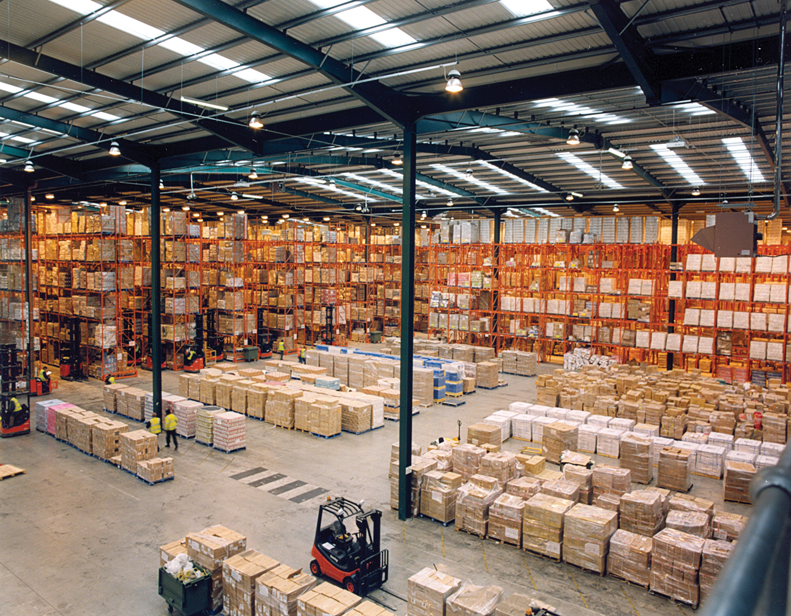

Slide 39
Warehouse operations
Take-in of goods
Placement of goods
Storage of goods
Internal relocation of goods
Changes in the properties of goods
Take-out of goods
Information flow support processes

Slide 40
Warehouse role in SCM system
The internal environment of the warehouse and the set of external environmental conditions ensure the individual character of each warehouse
Only an individual approach can be used to solve warehouse problems and improve efficiency.
The purpose of warehouse operations is to receive, process and deliver cargo with variable characteristics from an incoming to outgoing transport stream, at minimal cost and in accordance with customer requirements
Logistics Specialist Objective: Manage material flows to match outgoing goods flows with incoming ones according customer requirements and making optimal use of warehouse resources.

Slide 41
Cross – docking – a modern warehouse concept.
The function of the warehouse from the logistics point of view - change of parameters of cargo flows, not the place of storage of goods
The dominance of reception and pick-up areas by reducing or eliminating storage space
Distribution warehouses - where the unit of processing is one unit of cargo (the incoming flow is divided into outgoing transport units)
Distributing, sorting warehouses, where the transport unit is dismantled and the boxes (or pieces) are collected for the customer

Slide 42
Basic principles of warehouse logistics:
Planning - division of warehouse into work areas and ordering of cargo movement
Rationality - planning the movement of material values by minimizing processing operations and eliminating backflows (retrograde flows)
System approach - cargo flow planning based on cargo characteristics and inbound / outbound cargo flows
Efficient use of warehouse capacity - For cargo storage with maximum utilization of all storage volume
Providing access to stored cargo for the rational creation of cargo flows and the use of warehouse equipment
Optimal equipment - sufficient volume, multifunctional, reliable and fast

Slide 43
Incoming freight flows are planned in cooperation with the procurement department
Choosing the optimal suppliers
Delivery schedule
Mechanization of unloading operations, reducing loading time
Nomination of warehouse cargo units according to cargo transportation unit
Reduction of order completion time
Specific and special deliveries
Managing and optimizing delivery frequency as needed
Development and maintenance of an inventory management system
Reduction of transshipment times within technological operations.

Slide 44
Outbound freight flow planning in collaboration with sales and marketing
Development of customer service policy
Sales promotions
Optimal use of labor and materials
Fast and timely order execution
Reduction of load handling time
Special deliveries or self-export
Urgent delivery
Optimization of consignment lots
Retrograde (back) deliveries
Rational choice of transport modes
Sales plan.

Slide 45
Warehousing
Warehouse perimeter security
Open warehouses - cargo areas
Sheds - for partial protection of the cargo from the external environment
Cargo barns - for complete protection
Dry cargo warehouses
Temperature controlled warehouses
Specialized warehouses.

Slide 46
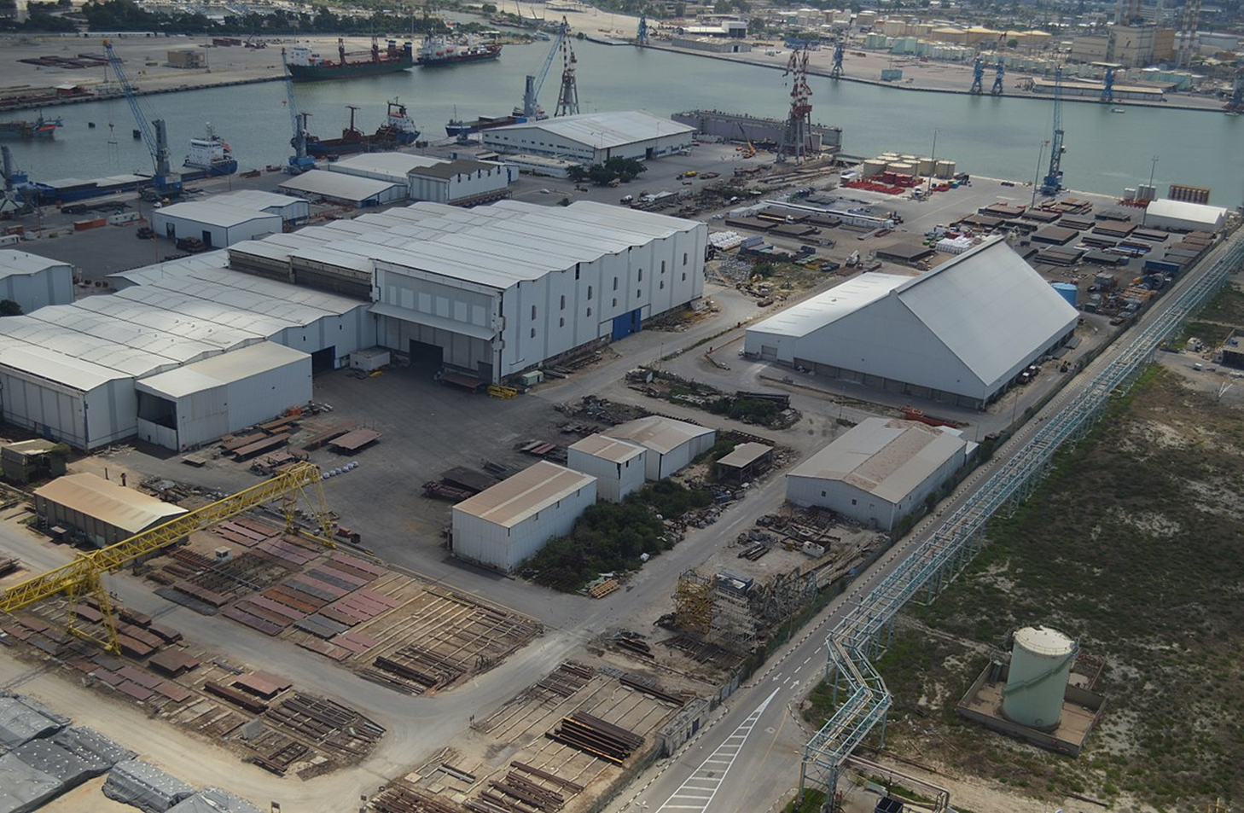

Slide 47
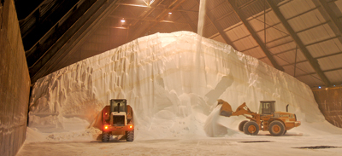

Slide 48
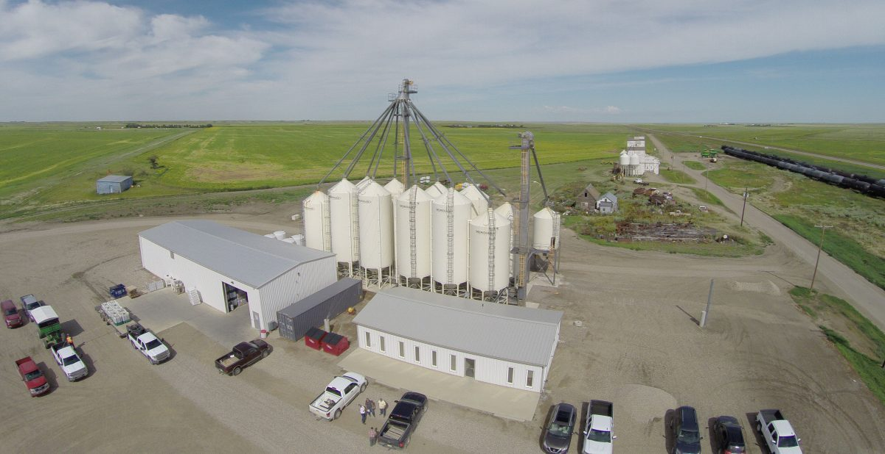

Slide 49
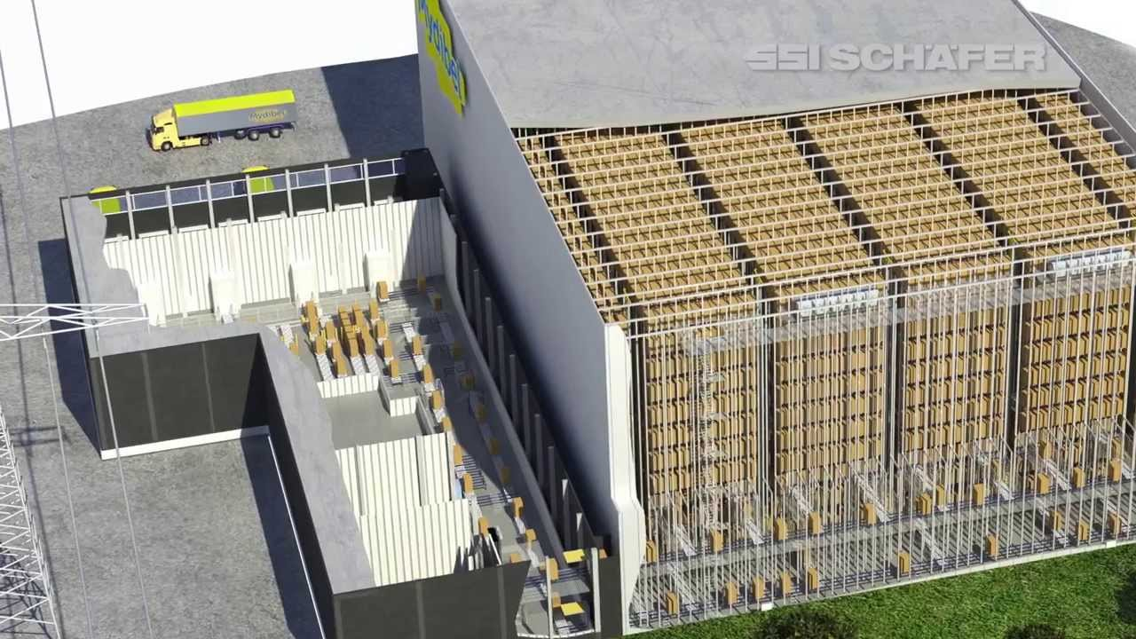

Slide 50
Most popular WMS
Fishbowl Inventory Software
Oracle Warehouse Management Software
Infor Supply Chain Management Software
JDA WMS Software
Tecsys WMS Software

Slide 51
1. Fishbowl Inventory Software
Integration with a third-party application is required and does not include an eCommerce or native shipping module
No on-premise installation
Limited options for social media integration
Only supports the English language
Does not support voice-to-pick or pick-to-light
Does not support collaborative inventory

Slide 52
6. Softeon WMS Software
Limitations
Some of the product limitations include: Does not support billing management. However, this solution can integrate with the Softeon Billing Management System for activity-based costing and billing
Does not provide an ROI tool to identify and improve supply chain inefficiencies
Does not include a robust labor management tool
Lacks payment processing functions
Softeon WMS Suite Support
Email: Clients can email Softeon about issues via their contact email address.
Phone: Phone support is available during normal business hours.
Training: Interested parties can go through Softeon’s online resources via their website to learn more about the product and how to use it.
Tickets: Tickets can be submitted through Softeon’s support page and will be answered in a timely manner.

Slide 53
10. SAP Warehouse Management
Limitations
Some of the product limitations include:
Does not support billing functionality, unlike SAP Hybris Billing
Limited BI functionality
Does not provide labor management functions
Does not contain payment processing functionality
Does not support integration with tools like QuickBooks or Xero
https://selecthub.com/supply-chain-management-software/fishbowl-inventory/?from_category=129

Slide 54
What is green logistics
Green logistics includes
lowering emissions
implementing more sustainable operations processes
reducing environmental pollution
solutions that companies can apply to be greener, from simple to very advanced, progressive actions.
The environmental issues in the world are only getting worse. So, it is now more important than ever for companies to get involved.

Slide 55
Green logistics and cocts reducing
An eco-friendly strategy focused on bringing in profit while helping the environment.
A sustainability approach can help companies have better brand representation and fewer expenses.
Integrating current processes and strategies to be “greener” and environmentally friendly can help companies increase efficiency and possibly decrease costs
Pool distribution helps reduce the wasted use of trucks and helps save costs
picking recyclable packaging materials
An energy management system is a set of tools for tracking, control, and optimization of the generation and use of energy
Warehouse space management play an influential role in environmental awareness as well.

