Slide 1
Subject: Cash-in-transit (CIT) security
23AUG2017

Slide 2
AGENDA
INTRO;
LEGAL REGULATIONS;
Cash in transit (CIT) cycle;
Risk assessment;
Execution;
Transport/Equipment;
Case study;
Work in groups (Recce/OPS planning);
Analyses/Discussions.
PART I
PART II

Slide 3
REGULATIONS
REGULATION (EU) No 1214/2011 OF THE EUROPEAN PARLIAMENT AND OF THE COUNCIL
of 16 November 2011
«on the professional cross-border transport of euro cash by road between euro-area Member States»
Applicable National regulations
f.ex. Latvia:
Apsardzes darbības likums;
MK noteikumi Nr.757 «Apsardzes darbības licncēšanas noteikumi»;
MK noteikumi Nr.738 «Noteikumi par caurlaidēm, kas dod tiesības transportlīdzekļu vadītājiem darba uzdevumu pildīšanas laikā neievērot atsevišķas ceļu satiksmes noteikumu prasības».

Slide 4
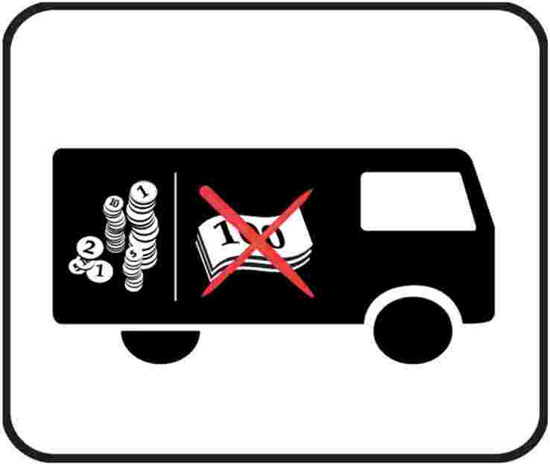
What is covered in 1214/2011
SECTION 1: COMMON RULES GOVERNING ALL CROSS-BORDER TRANSPORT OF EURO CASH BY ROAD;
SECTION 2: SPECIFIC RULES FOR EACH TYPE OFTRANSPORT;
SECTION 3: FINAL PROVISIONS;
ANNEX II: INTELLIGENT BANKNOTE NEUTRALISATION SYSTEM (IBNS);
ANNEX V: ARMOURING SPECIFICATIONS;
ANNEX VI: MINIMUM REQUIREMENTS OF INITIAL TRAINING FOR CIT SECURITY STAFF THAT CARRY OUT CROSS-BORDER EURO CASH TRANSPORT;
ANNEX VII: COUNCIL OF EUROPE’S COMMON EUROPEAN FRAMEWORK OF REFERENCE FOR LANGUAGES: LEVELS.

Slide 5
What is covered in National regulations
Who on what circumstances is allowed to provide CIT security service;
How he need to be equipped (GPS, IBNS etc.);
How the CIS security personnel need to look like, how they need to be identified, what documentation they need to carry;
What are the exceptions for CIT security regarding other regulations (f.e. Traffic law).
Other.

Slide 6
What would normaly be covered in National regulations
The LAW: Apsardzes darbības likums;
Regulations issued by the Cabinet of Ministers:
ANNEX II: INTELLIGENT BANKNOTE NEUTRALISATION SYSTEM (IBNS);
ANNEX V: ARMOURING SPECIFICATIONS;
ANNEX VI: MINIMUM REQUIREMENTS OF INITIAL TRAINING FOR CIT SECURITY STAFF THAT CARRY OUT CROSS-BORDER EURO CASH TRANSPORT;
ANNEX VII: COUNCIL OF EUROPE’S COMMON EUROPEAN FRAMEWORK OF REFERENCE FOR LANGUAGES: LEVELS.

Slide 7
Definition
Normally with CIT we understand – physical transfer of banknotes, coins, items of significant value from one location to another.
The locations can include cash centers, banks, ATM points, retailers and other premises holding large amounts of cash.
Important to remember – it is a cycle (complex process) consisting of several steps.
Definition provided by Competition Council of the Republic of Latvia:
CIT security is a complex service, consisting of several steps which together are making cycle. First step: cash has been gathered from the client. Second step: cash has been transported to the cash holding (handling) facility. Third step: cash handling in the cash center. Fourth step: cash holding, transferring to the clients account or transferring to clients designated destination.

Slide 8
CIT (Cycle):
Step: Cash transferring to/from client or clients technical systems (ATM, etc.);
Step: Cash transferring to/from cash holding (handling) facility (center);
Step: Cash handling in cash holding (handling) facility (center);
Step: cash holding, transferring to the clients account or transferring to clients designated destination.

Slide 9
Risk assessment
Each object, each CIT OPS is Unique;
All process is subjected to a significant Risk;
CIT process in objective;
Inside threat;
CIT process during transportation;
Returning to vehicle with material goods (cash).

Slide 10
Execution
Detailed examination and evaluation of the object;
Risk assessment is conducted,
The possible execution has been analyzed and a plan has been drawn up, which defines:
OBJ access points,
Personnel and vehicle movement routes,
Recommendations for driving and parking at the OBJ,
Transportation type;
Number of personnel in the team;
Number of teams
Other activities to eliminate the risk
Signing of contract
OBJ included in the security companies route.

Slide 11
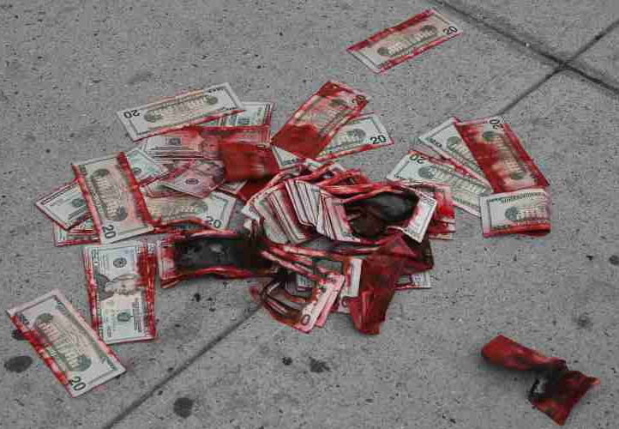
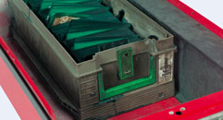
Execution
Execution can be conducted:
1x man team (+ IBNS);
2x man team (most common);
3x man team (rare).
Note: defined by risk/costs

Slide 12
Execution
Risk assesment will define:
Transportation (what type);
Composition of team;
Armoment;
Number of teams;
Involment of government law enforcement agencies;
Other means and equipment to eliminate the risks.
Costs!!!

Slide 13
Case study: Latvia
Year 2000. (Armored robbery "Pirmās Latvijas komercbankas" CIT vehicle);
Year 2007.gads (False CIT security employee deceives more than 10K lats);
Year 2008;
Year 2010.

Slide 14
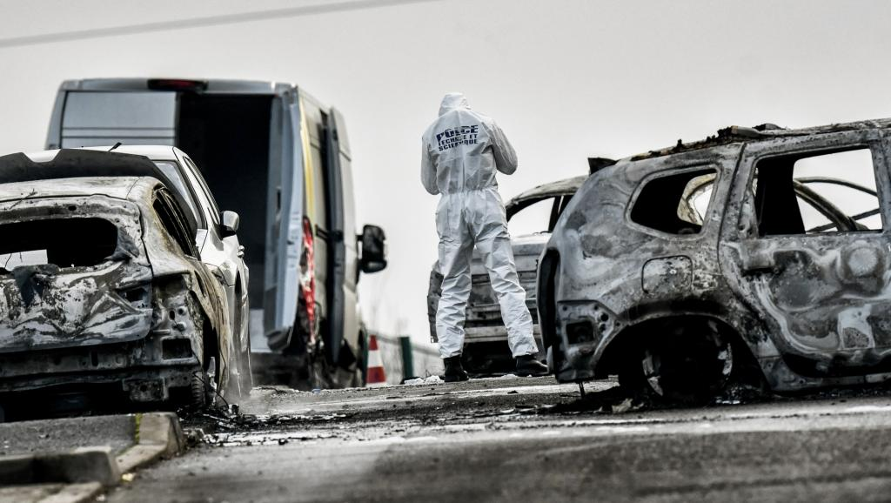
Case study
Year 2016.DEC France (video);
Year 2014. UK (video);
Year 2009. Sweden (video).

Slide 15
Work in Groups
Task: prepare detailed examination and evaluation of the object;
OBJ access points,
Personnel and vehicle movement routes,
Recommendations for driving and parking at the OBJ,
Transportation type;
Number of personnel in the team;
Number of teams
Other activities to eliminate the risk (proposals)

Slide 16
Noderīgi info avoti:
Eiropas Inteliģentā naudas aizsardzības asociācija (EURICPA): http://euricpa.org/euricpa/members.html

Slide 17
Discussions/Questions?

