Slide 1
Conferencing in criminal cases
Lecturer: Dana Rone

Slide 2
Method
Maori tribes, New Zealand
A tribe adopts decision how to help to the victim and what to do with a perpetrator
Communication skills – essential
Ability to ask questions – essential
Neutrality – essential
Don’t be an expert in other’s situation

Slide 3
Method
Questions must be aimed to constructive solutions, not judging or pittying
A chance to ask questions and get answers
To get fulfillment of one’s needs
If mediator is nervous, but verbally saying nice things, nobody believe
Both – verbal (10%) and non-verbal communication (90%) is essential
http://www.etiquetteoutreach.com/blog_new-york-etiquette-guide/bid/86444/Body-Language-Breakdown-Crucial-Tips-and-Faux-Pas - Body language

Slide 4


Non verbal communication: 1) Facial expressions

Slide 5
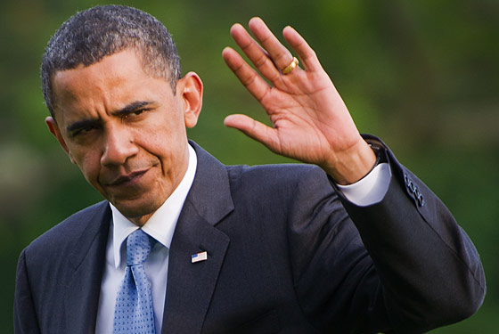
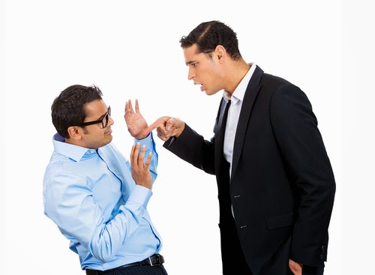
Non verbal communication: 2) Gestures https://www.youtube.com/watch?v=_8hAOxsTpVY

Slide 6
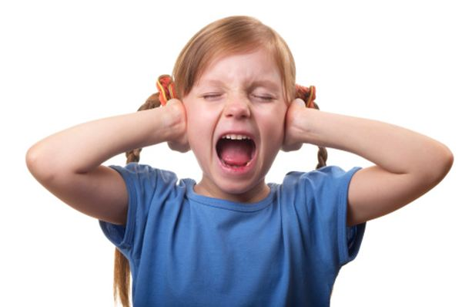

Non verbal communication: 3)Paralinguistics (tone of voice)

Slide 7
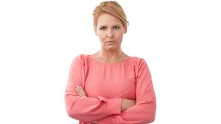

Non verbal communication: 4)Body Language and Posture

Slide 8
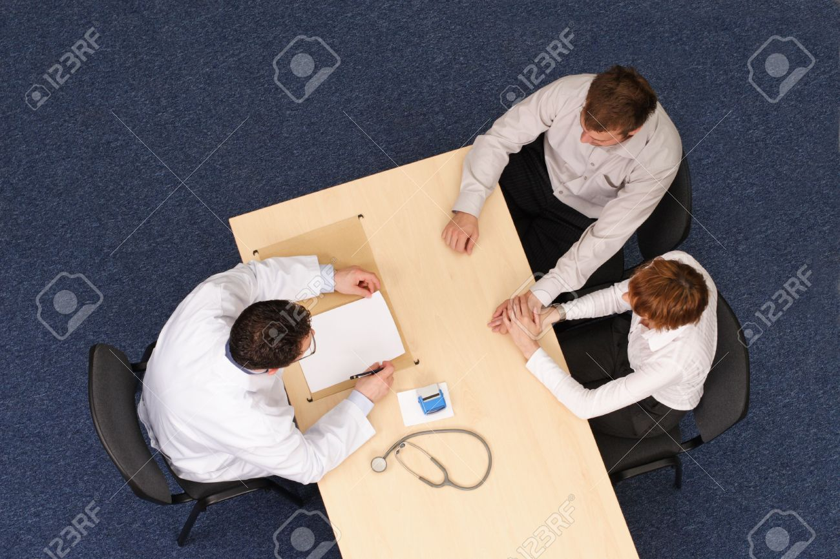
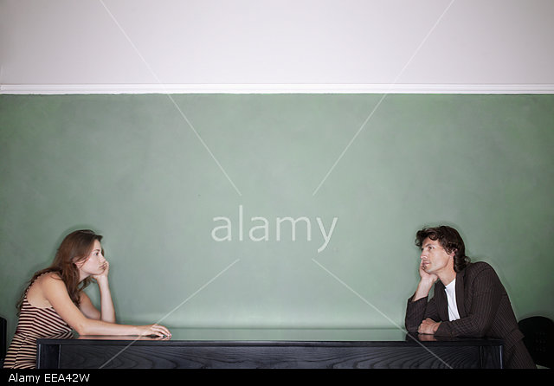
Non verbal communication: 5)Proxemics (personal space)

Slide 9

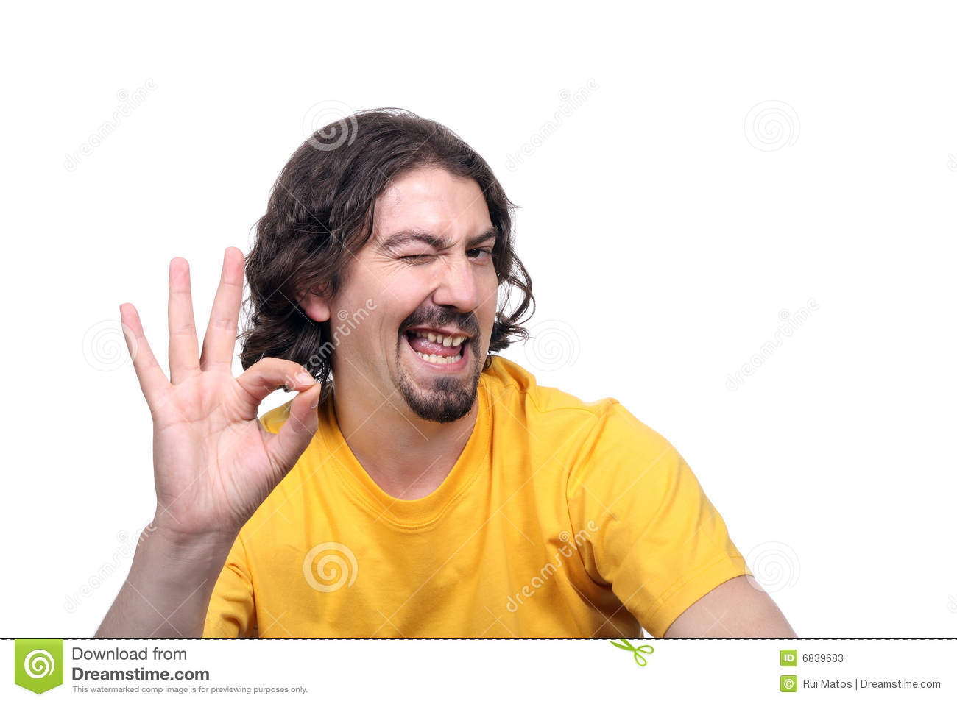
Non verbal communication: 6)Eye gaze

Slide 10
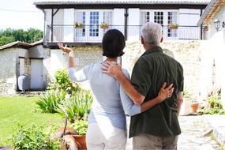
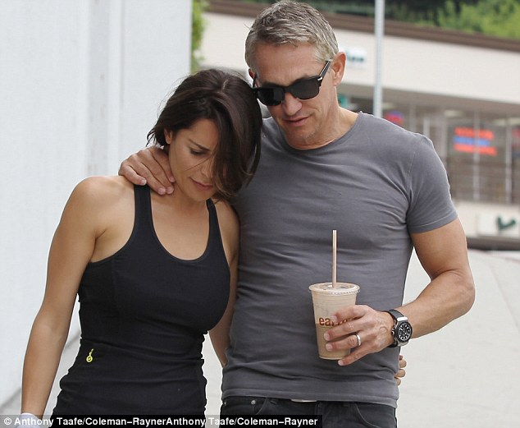
Non verbal communication: 7)Haptics (touch)

Slide 11
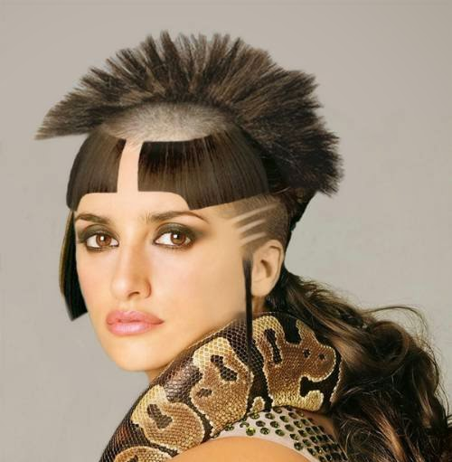
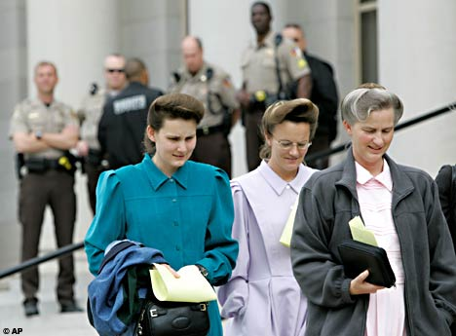
Non verbal communication: 8)Appearance (outlook)

Slide 12
5 questions aimed at restorative justice
What happened? – Lets person speak about particular situation
What do you think about what happened? – Learn about motivation and reaction after event.
What did you feel?
Who was affected by this event?
What should you do now?

Slide 13
Conferencing meeting
2 mediators (because there is higher risk that in the larger group discriminatory elements will be – gender, age, etc.)
Victim/-s, offender/-s, supporter/-s
Long and effective prior planning of conferencing meeting
Knowing participating parties, their mutual relations

Slide 14
Conferencing meeting – mediators sit in front of each other & visually cover the field
Mediator 1
A E
B F
C G
D H
Mediator 2

Slide 15
Conferencing meeting – mediators sit in front of each other & visually cover the field
Mediator covers the persons sitting in front of him
Better eye contact
Balanced neutrality

Slide 16
Getting prepared for conferencing meeting
Know participants – get acquainted before
Needs, expectations and concerns
Check arriving possibilities (and mind diseabled)

Slide 17
Social network in conferencing meeting.
Better few, but real supporters.
Some has many supports, some – none
Relatives Friends
Acquaintances Police

Slide 18
Getting prepared for conferencing meeting
Show the room, where conferencing will take place
Victim and offender sits in front of each other
Victim must sit in a place, from which he/she can leave any time, not passing by the offender
Minor’s parents sit besides the child (if someone sits between, the parents will attack offender, which is a normal reaction)

Slide 19
Structure of mediation. 1 - Past
What happened?
How did it happen?
Who took part in it?
Historical events are discussed, summary - made

Slide 20
Structure of mediation. 2 - Present
What do you think about this today?
How do you feel today about that?
What are the consequences on your life today?
How this affected you and your current life?
Whould you like to change this situation?
What are you ready to do about this?
Mediator helps identify feelings, especially of the victim. A perpatrator must see the consequences of his/her offence, and offer the help to the victim.

Slide 21
Structure of mediation. 3 - Future
What you will need to leave this in past?
What solution do you offer?
What do you think about his/her needs?
What can you do to improve the situation?
Parties are going fo resulution as precise as possible.

Slide 22
Speaking sequence and tips
The 1st speaks the perpetrator (thus he/she takes responsibility and recognizes the fault)
Everybody must speak for himself/herself
Not “we”, but “I”
Equal questions, equal timing for everyone
The perpetrator gets a chance to know how his/her behaviour affected the victim and other society – supporters, relatives, friends, colleagues, etc.

Slide 23
Secondary victimization
Psychological reaction (anger, fear)
Physical reaction (sickness, tearfulness)
Behavioral reaction (alcohol, drugs, isolation)
Ask the victim, does he/she agree to meet with the perpetrator

Slide 24
4 stage recovery model
Shock, denial (a stable person must assist, be besides)
Disorganization, depression (reactive phase; victim feels emotions, is in affect phase 4 – 6 weeks)
Recovery, acceptance (6 – 12 months)
Return back to normal, adaptation (old habits return, new habits come)

Slide 25
4 stage recovery model
1. 4.
2. 3.

Slide 26
Factors affecting recovery
Has person been a victim before?
Has person experienced severe loss recently?
Lack of (emotional, physical, etc.) support
Type of crime
Anamnesis* of mental health
* The complete history recalled and recounted by a patient

Slide 27
Secondary victimization
Mental stress caused by inadequate and negative reaction of society
Mind society’s attitude towards the victim
Mediator affects secondary victimization risk
A lot of attention shall be paid to the victim in mediation process
A victim must be especially informed about mediation, possible agreement, its consequences, the process

Slide 28
Secondary victimization
If victim is not efficiently heard:
False expectations
Dishonour of promises
Later control over situation
Lack of respect towards victim

Slide 29
Final remarks
“Would you like to say something in addition?”
“Would you like to appologize?”

Slide 30
How to speak in mediation?
“We will analyze” / “You will analyze”
“Can you tell us what you did?”
Don’t suggest solutions
“Is there anything you would like to receive?”

Slide 31
Perpetrator’s concerns
Public hearing and public humiliation (mediator explains rules and doesn’t allow offences)
Fears from public speach (mediator speaks simply)
Emotional pressure (a break is possible in mediation)
Will the process be effective
Wide-spread information about process (confidentiality is observed)

Slide 32
Perpetrator’s parents’ concerns
The child will be punished
What society will think about their child?
Will they be able to cover damages?
What will be the future of their child?
Therefore mediator shall:
create safe environment
explain the process
provide information

Slide 33
Concerns of professionals (police, teachers)
How it will affect my environment? – Necessity to settle the environment
How will affect the future? – Mind the reason
The professional will be blamed about bad performance. – Explanation that a breach of offender is reviewed, not the performance of professional.

Slide 34
Victim’s concerns
Not to be repeatedly victimized (secondary victimization). – Safe environment, sufficient information.
Attacks from the side of perpetrator. – Do not give hopes about certaintly of agreement.
To get confused during mediation. Lack of ability to protect himself/herseft. – To get a supporter.

Slide 35
Thank you!

