Slide 1
Basics of Alternative Dispute Resolution
Assoc. prof. Agnė Tvaronavičienė
19th July, 2016

Slide 2

TASK No 1
HOW DO YOU UNDERSTAND CONFLICTS?
WORKING IN GROUPS OF 5-7 PERSONS.
Task should be completed within 15 minutes.
Notes:
Taikinamojo tarpininkavimo metu gali dalyvauti tik ginčo šalys, jų atstovai ir taikinimo tarpininkas. Ginčo šalių prašymu arba sutikimu taikinamojo tarpininkavimo metu gali dalyvauti ir kiti asmenys. Taikinimo tarpininkas, nustatęs, kad yra ir daugiau sprendžiamo ginčo šalių, pasiūlo šioje ginčų sprendimo procedūroje dalyvaujančioms ginčo šalims susitarti su kitomis ginčo šalimis dėl ginčo sprendimo taikinamojo tarpininkavimo būdu.

Slide 3
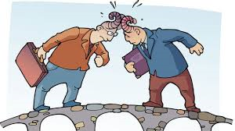
DEFINITION OF THE CONFLICT (1)
How can we name opposition of interests?
Disagreement » opinion differences or simply differences in points of view.
Conflict » disagreement followed by actions against each other.
Dispute » disagreement connected with violation of rights (legal concept).

Slide 4
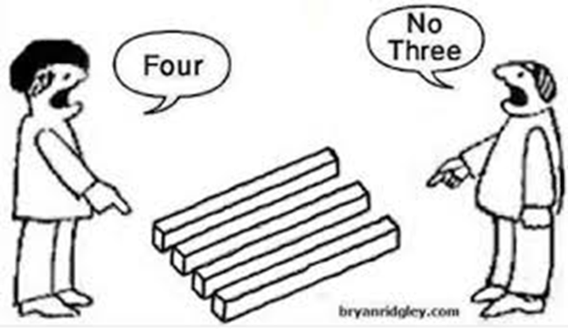
The same issue may cause disagreement, conflict, dispute or even WAR!

Slide 5

DEFINITION OF THE CONFLICT (2)
CONFLICT » an expressed struggle between at least two interdependent parties who perceive incompatible goals, scare resources, and interference from others in achieving their goals.
Main features:
Active confrontation
Two or more parties (!)
Opposite interests

Slide 6
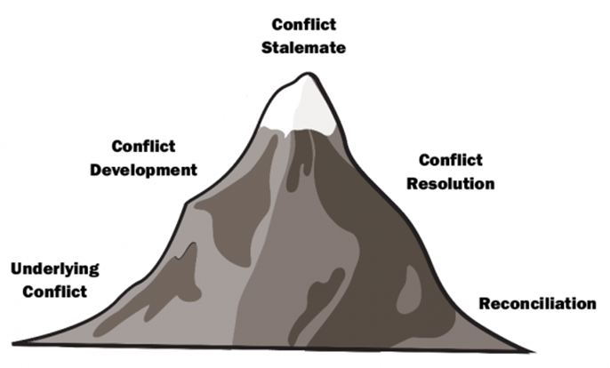
STAGES OF THE CONFLICT
The results of conflict resolution stage is are very important for reaching reconciliation and transforming conflict from negative towards positive influence in regard of relationship.

Slide 7
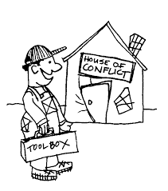
CONCEPT OF ALTERNATIVE DISPUTE RESOLUTION
ADR in general – variety of dispute resolution methods, which are oriented towards resolution of disputes without litigation.
Features of ADR:
Informality;
Allowance for the parties to control the procedure as
well as it’s outcomes;
Possibility to involve the third neutral person;
Special role of neutrals (if they are involved).

Slide 8
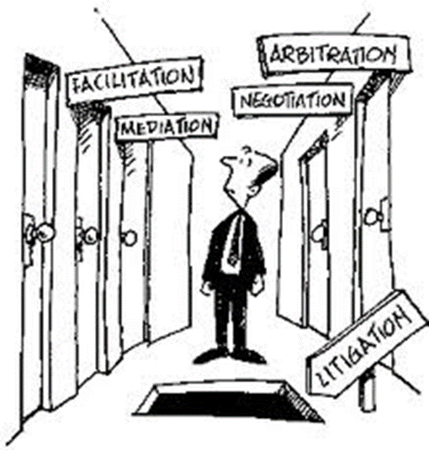
MAIN ADR METHODS
Negotiations
Mediation
Arbitration

Slide 9

NEGOTIATIONS
This type of ADR aims for the parties to settle the dispute by negotiating and deliberating with each other with the attendance of their attorneys if needed, without intervention of any third party.
Main features of negotiations:
almost always attempted first to resolve a dispute;
allows the parties to meet in order to settle a dispute;
allows the parties themselves to control the process and the solution;
do not requires involvement of the third party;
informal, low cost, high speed private future oriented
procedure;
helps to restore relations.

Slide 10

MEDIATION
This type of ADR means the settlement of a dispute by setting up an independent person between two contending parties in order to aid them in the settlement of their disagreement.
Main features of mediation:
allows the parties themselves to control the process and the solution;
requires involvement of the third neutral party (mediator);
mediator bring opposing parties together and encourages
them to work out a settlement;
informal, low cost, high speed, private, future oriented,
voluntary procedure;
helps to restore relations;
focuses on underlying interests.

Slide 11

ARBITRATION
This type of ADR means the hearing and determining of a dispute between parties by a person or persons (arbitrators) chosen or agreed to by the parties. Arbitration award is recognized and enforceable under the law.
Main features of arbitration:
voluntary (on the bases of arbitration clause or agreement);
a simplified version of a trial;
parties can agree on arbitral panel, procedural rules, language, applicable law, place of hearings and etc.;
decision is mandatory to follow;
formal, more expensive, slower and past oriented private procedure;
adjudicative method;
focuses more on legal issues and do not take into considerations
other aspects, what might be important;
not all disputes may be resolved in arbitration.
Arbitration might be binding and non-binding.

Slide 12
HYBRID PROCEDURES
These ADR methods combines two or more traditional ADR methods (negotiations, mediation and arbitration).
Main hybrid procedures:
MedArb (third person starts as a mediator but in the event of a failure of mediation, the arbitrator imposes a binding decision);
ArbMed (during the arbitration process, mediation is applied. In case of its failure, arbitrator imposes a binding decision);
Neutral evaluation (expert in certain area investigates the case material and informs parties about the strong and weak points of their positions);
Private judging / rent a judge (presenting case to a retired or former judge in a privately maintained courtroom with all the appurtenances of the formal judicial process).
and etc.

Slide 13
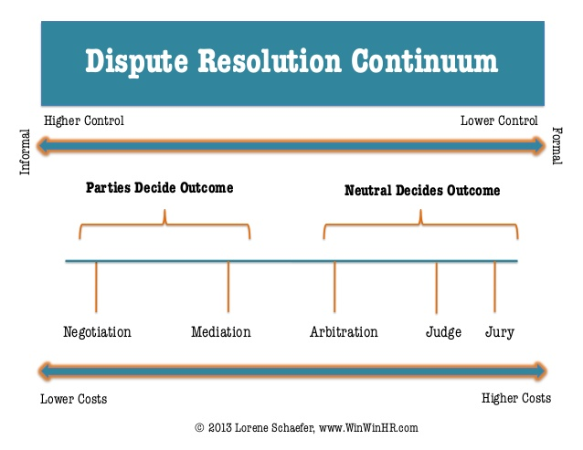
ADR procedures

Slide 14
HOW TO CHOOSE MOST APPROPRIATE DISPUTE RESOLUTION METHOD?
Please take into account:
character of a dispute;
personal features of the parties;
negotiation style of the parties;
financial status of the parties;
time limits for resolution;
duration of relations between the parties;
level of personal emotional involvement of the parties into a dispute;
level of the conflict escalation

Slide 15

ESCALATION OF CONFLICT (1)
Conflicts till the reaching the stage of resolution may be escalated in diferent levels.
Please have a look ☺

Slide 16

ESCALATION OF CONFLICT (2)

Slide 17
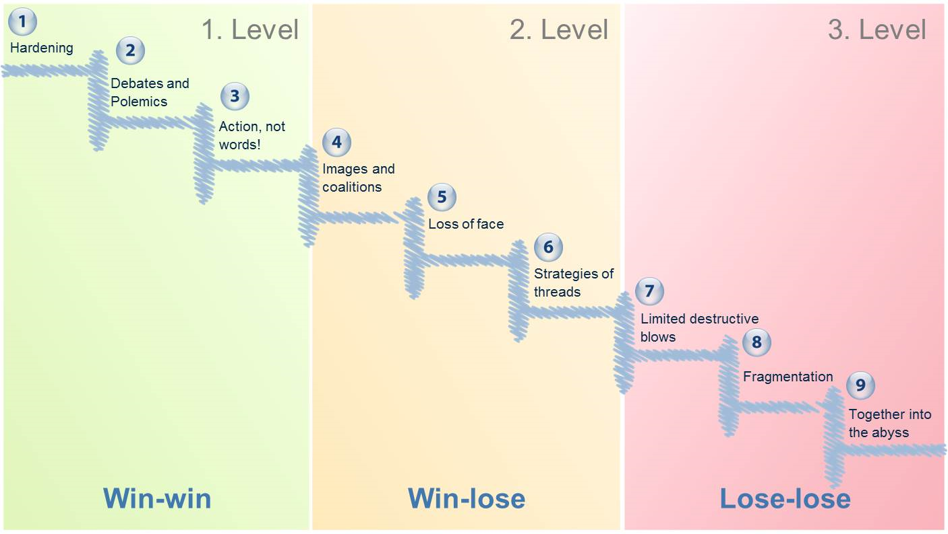
ESCALATION OF CONFLICT (3)
In order to choose correctly the certain dispute resolution method it is advisable to use Glasl‘s model of „Conflict escalation stages“.

Slide 18
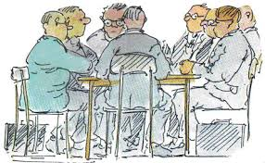
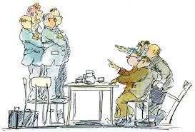
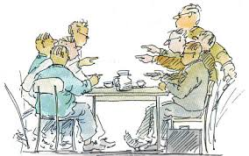
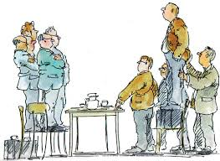
1st stage - Hardening 3rd stage – Actions not words
2nd stage – Debate / Polemics 4th stage – Images / Coalitions
Notes:
- Hardening. Irritation over the issue leads to a hardened stance in the interaction
- Debates. The irritation is vented through debate and arguments.
- Actions, not words. The time for talk has passed, it’s time for action to reach your goal.
- Image and coalition. Support is sought from others to boost reputation.
- Loss of face. Backing down is no longer an option. Images and position start to polarize.
- Strategies of threats. In this phase threats will be used to try and ‘win’ the conflict.
- Limited destruction. Words as ‘eliminate’ en ‘exterminate’ are used in the escalation.
- Viewing as enemy. The other party is viewed as an enemy that must be destroyed.
- Together into the abyss. Self-preservation is neglected. All reason is abandoned.

Slide 19
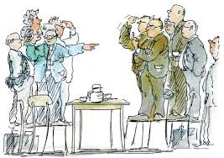
5th stage – Loss of Face 7th stage – Limited destructive bowls
6th stage – Strategies of Threats 8th stage - Fragmentation
Notes:
- Hardening. Irritation over the issue leads to a hardened stance in the interaction
- Debates. The irritation is vented through debate and arguments.
- Actions, not words. The time for talk has passed, it’s time for action to reach your goal.
- Image and coalition. Support is sought from others to boost reputation.
- Loss of face. Backing down is no longer an option. Images and position start to polarize.
- Strategies of threats. In this phase threats will be used to try and ‘win’ the conflict.
- Limited destruction. Words as ‘eliminate’ en ‘exterminate’ are used in the escalation.
- Viewing as enemy. The other party is viewed as an enemy that must be destroyed.
- Together into the abyss. Self-preservation is neglected. All reason is abandoned.

Slide 20
9th stage – Together into Abyss
Notes:
- Hardening. Irritation over the issue leads to a hardened stance in the interaction
- Debates. The irritation is vented through debate and arguments.
- Actions, not words. The time for talk has passed, it’s time for action to reach your goal.
- Image and coalition. Support is sought from others to boost reputation.
- Loss of face. Backing down is no longer an option. Images and position start to polarize.
- Strategies of threats. In this phase threats will be used to try and ‘win’ the conflict.
- Limited destruction. Words as ‘eliminate’ en ‘exterminate’ are used in the escalation.
- Viewing as enemy. The other party is viewed as an enemy that must be destroyed.
- Together into the abyss. Self-preservation is neglected. All reason is abandoned.

Slide 21
STAGE OF ESCALATION AS KEY FOR CHOOSING ADR METHOD

Slide 22

TASK No 2
Please fill the presented form
(individual work)

Slide 23


